Slide 1
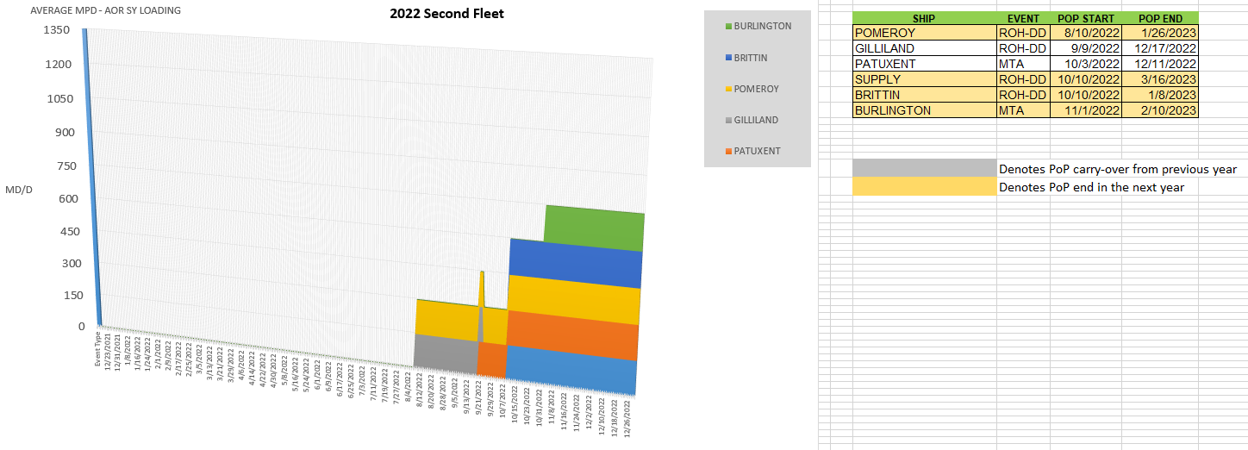
2nd Fleet – 2022 Shipyard Loading
UNCLASSIFIED
United We Sail
1

Slide 2
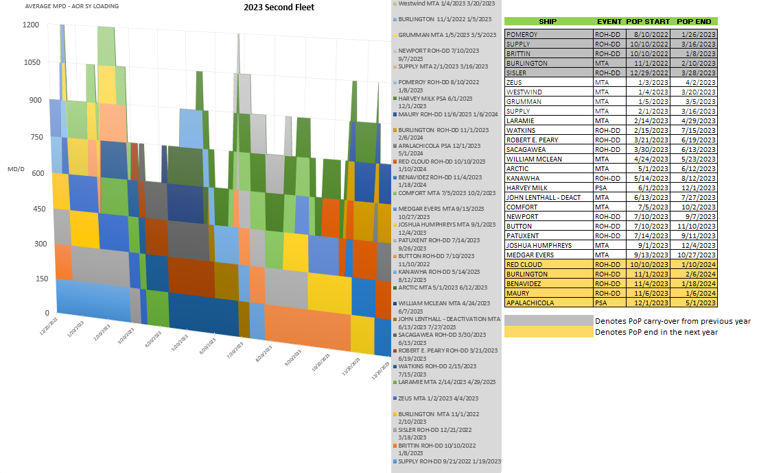
2nd Fleet – 2023 Shipyard Loading
UNCLASSIFIED
United We Sail
2

Slide 3
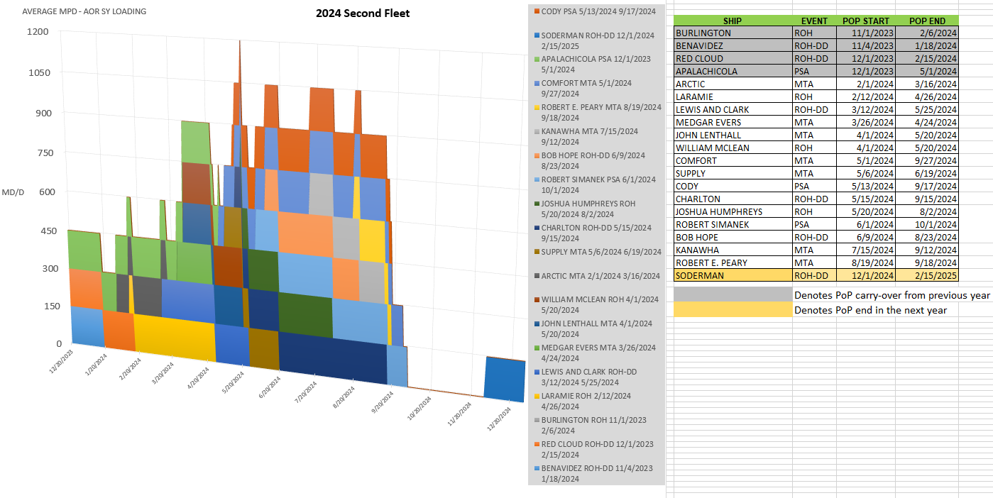
2nd Fleet – 2024 Shipyard Loading
UNCLASSIFIED
United We Sail
3

Slide 4
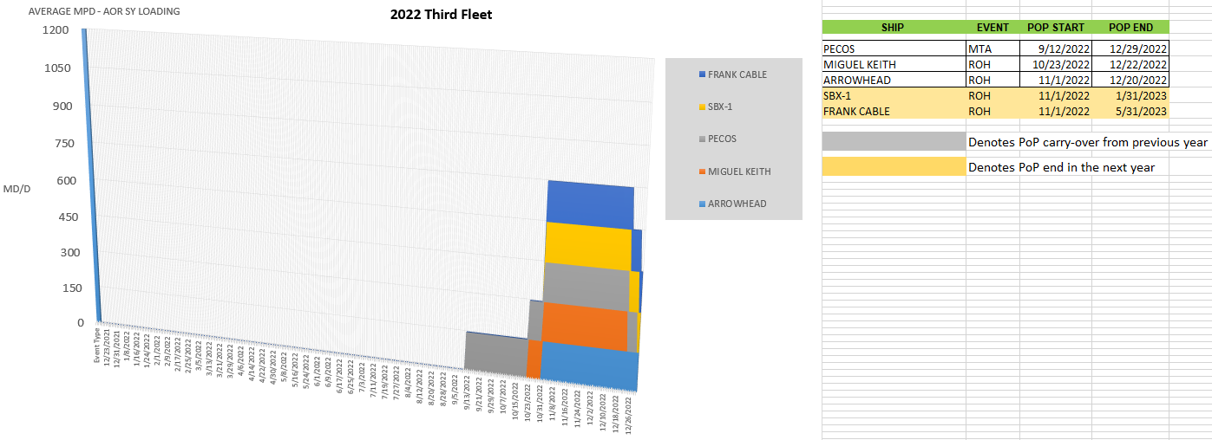
3rd Fleet – 2022 Shipyard Loading
UNCLASSIFIED
United We Sail
4

Slide 5
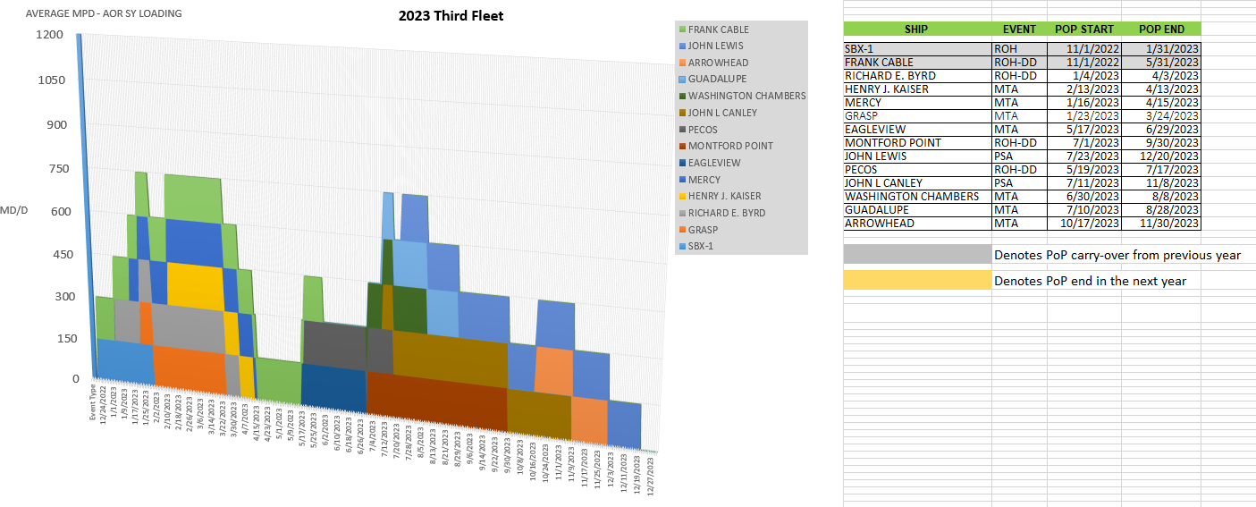
3rd Fleet – 2023 Shipyard Loading
UNCLASSIFIED
United We Sail
5

Slide 6
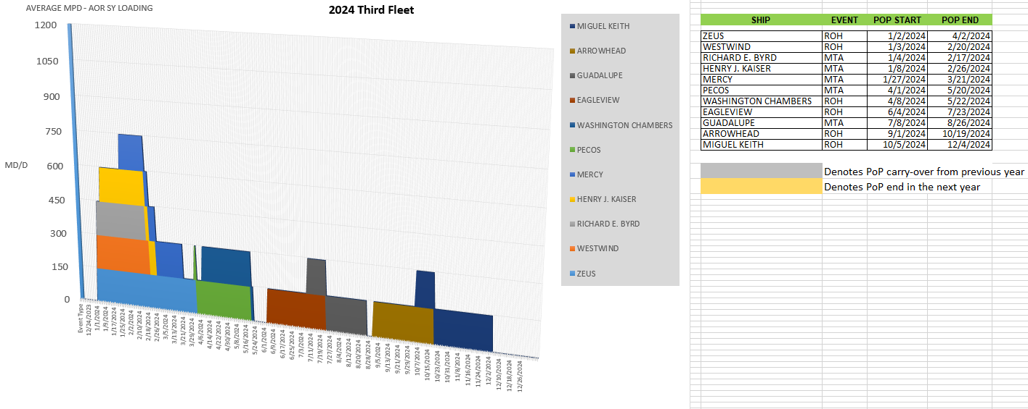
3rd Fleet – 2024 Shipyard Loading
UNCLASSIFIED
United We Sail
6

Slide 7
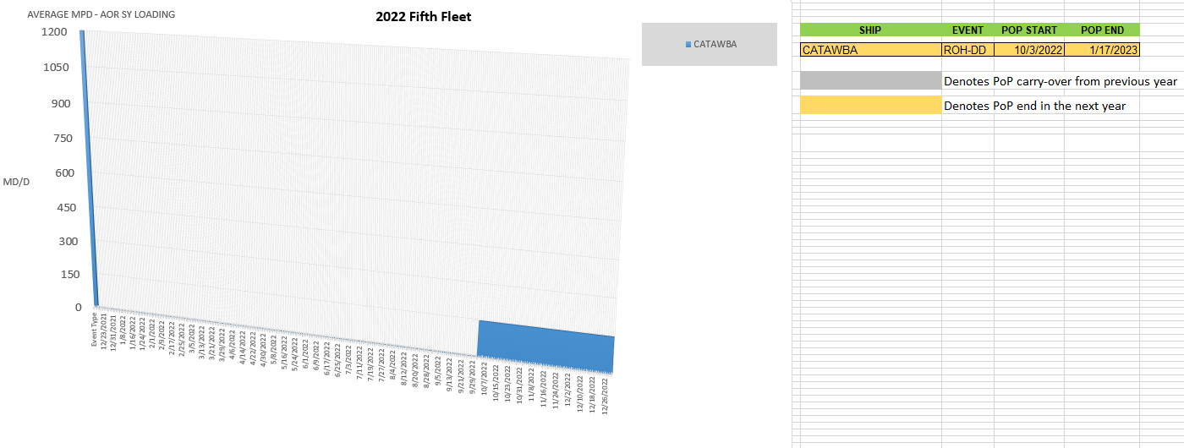
5th Fleet – 2022 Shipyard Loading
UNCLASSIFIED
United We Sail
7

Slide 8
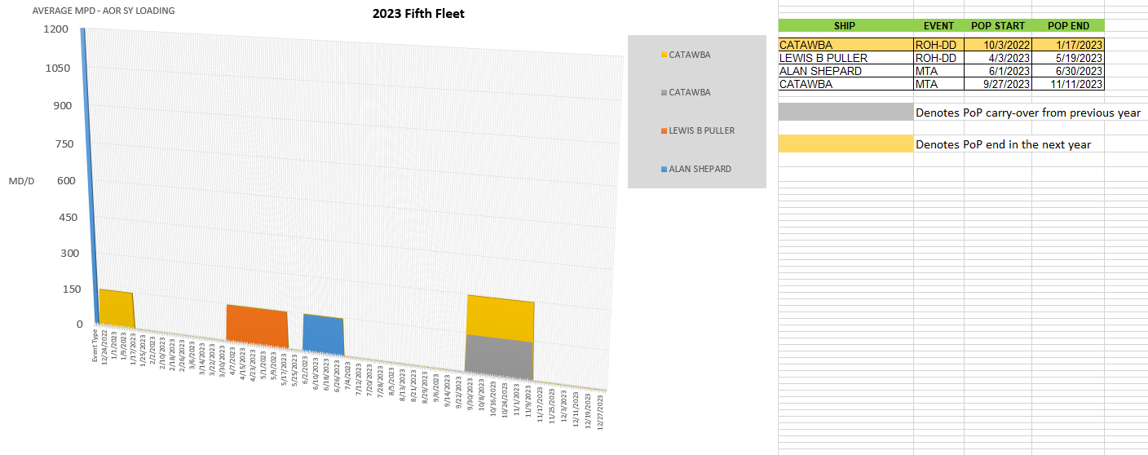
5th Fleet – 2023 Shipyard Loading
UNCLASSIFIED
United We Sail
8

Slide 9
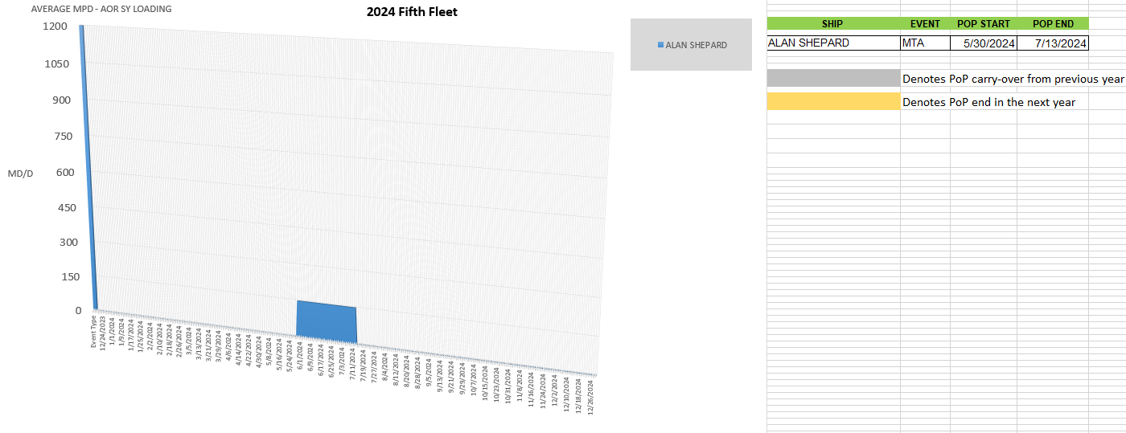
5th Fleet – 2024 Shipyard Loading
UNCLASSIFIED
United We Sail
9

Slide 10
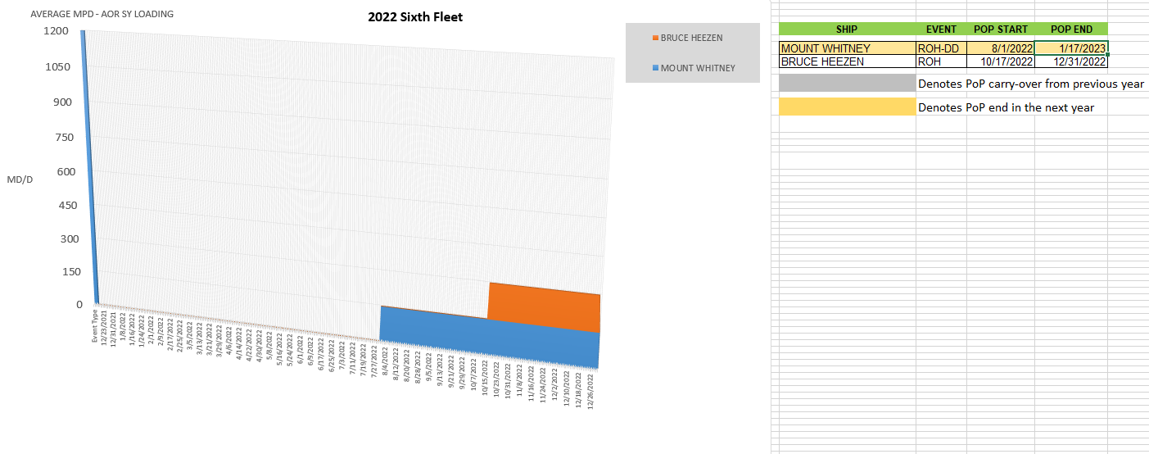
6th Fleet – 2022 Shipyard Loading
UNCLASSIFIED
United We Sail
10

Slide 11
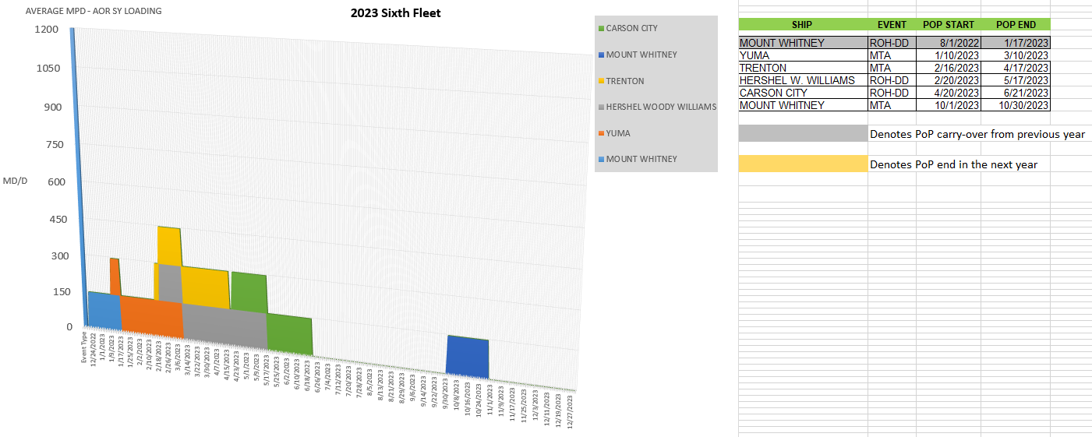
6th Fleet – 2023 Shipyard Loading
UNCLASSIFIED
United We Sail
11

Slide 12
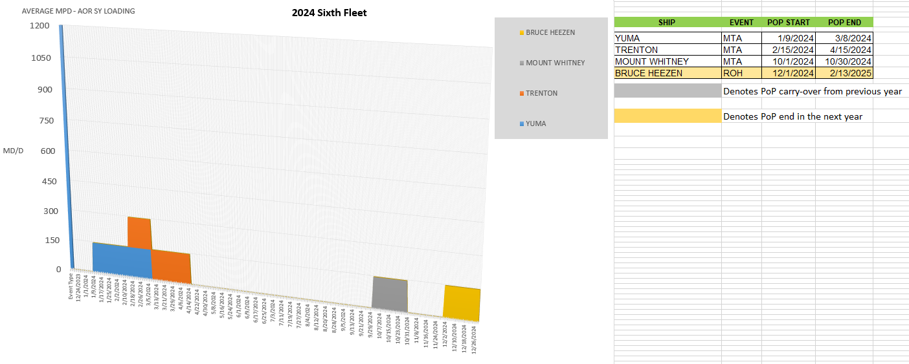
6th Fleet – 2024 Shipyard Loading
UNCLASSIFIED
United We Sail
12

Slide 13
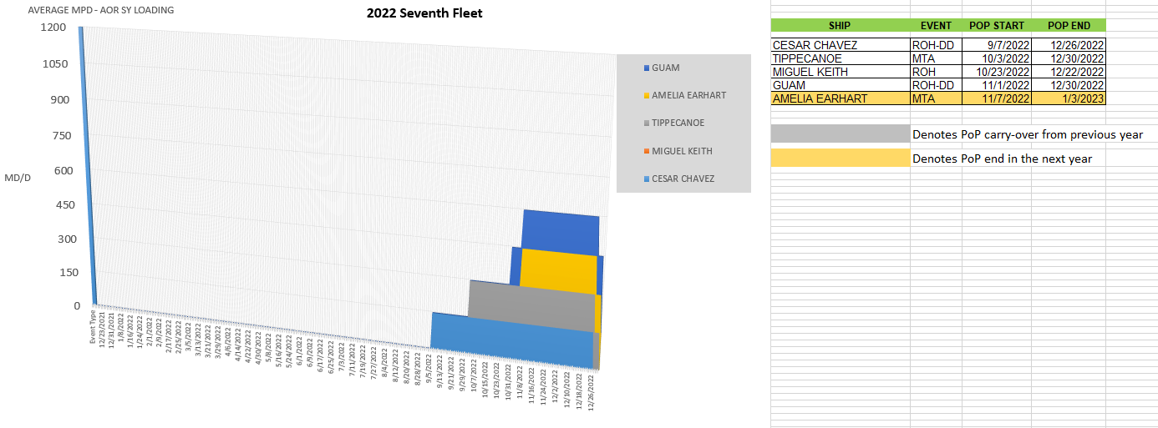
7th Fleet – 2022 Shipyard Loading
UNCLASSIFIED
United We Sail
13

Slide 14
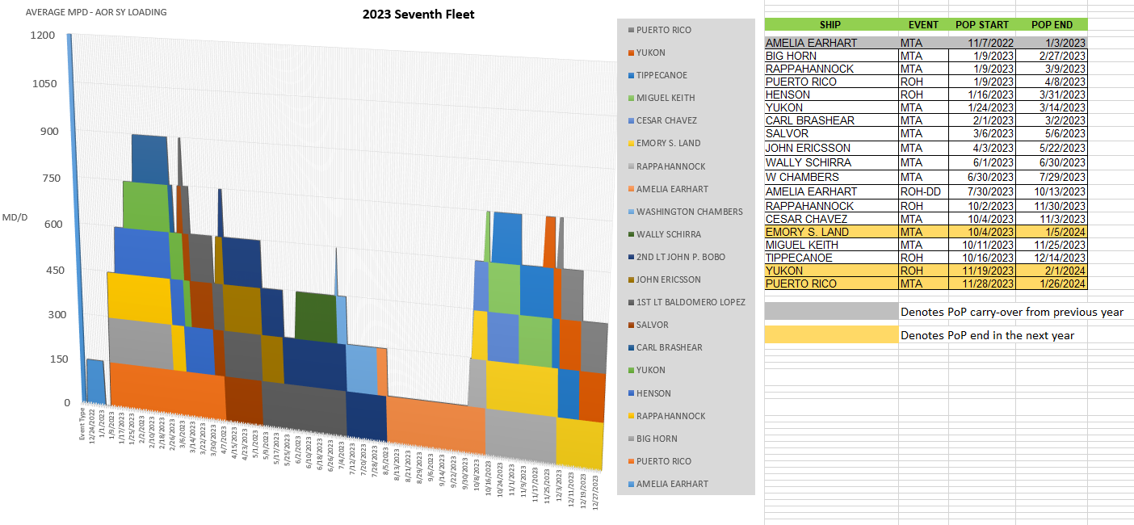
7th Fleet – 2023 Shipyard Loading
UNCLASSIFIED
United We Sail
14

Slide 15
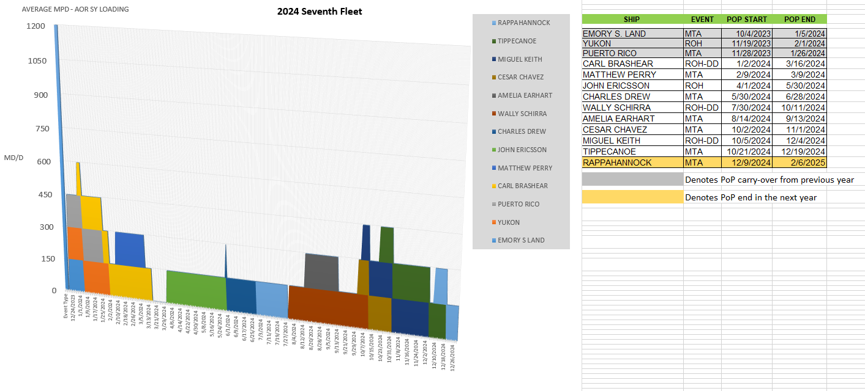
7th Fleet – 2024 Shipyard Loading
UNCLASSIFIED
United We Sail
15

